Slide 1



Cover Page
Friday, 17 Oct 2025
PROJ703/ PROJ903 International Challenge Project “Eurobot”
By
ROBO-UN
Page-01

Slide 2
Table of Content
Progress Report -03
Simulation -04
Design -05
Strategies -06
Project Management -07
Page - 02

Slide 3
PROGRESS REPORT
What we have done:
  Simulation: Animated basic components of the game
  Design: The concept of employing slide rails and sliders
  Strategies: First drafts of routing ideas
What we have to do for next session:
  Simulation: Start simulating our routes
  Design: Refine design
  Strategies: Refine drafts
  Research: Object/color detection via OpenCV
  Selection of Eletronic Components
Page - 03

Slide 4
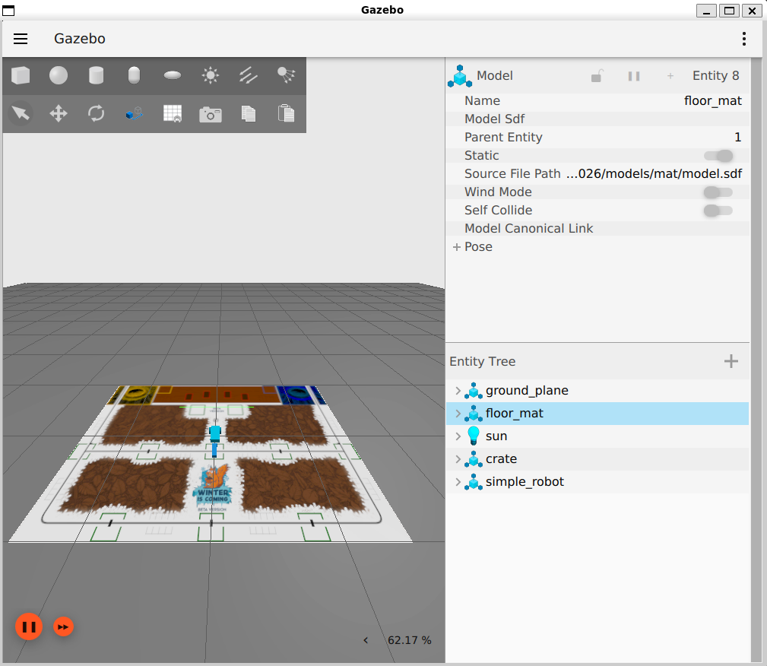
SIMULATION
Rover moves and crates can be pushed by rover
Game mat will be replaced with new version ASAP
Computer issues slow progress significantly
HELP.mp4
Page - 04

Slide 5
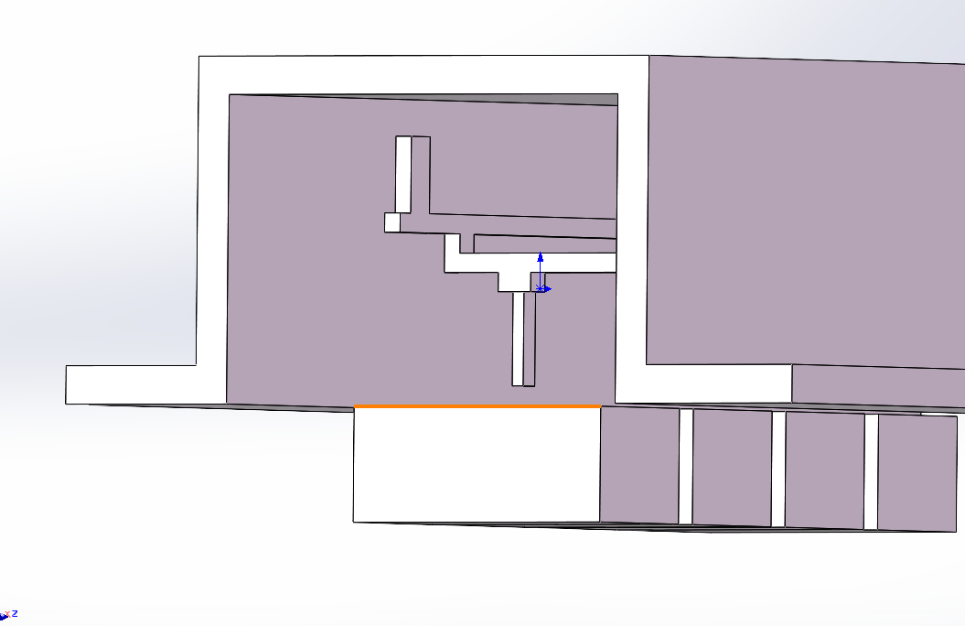
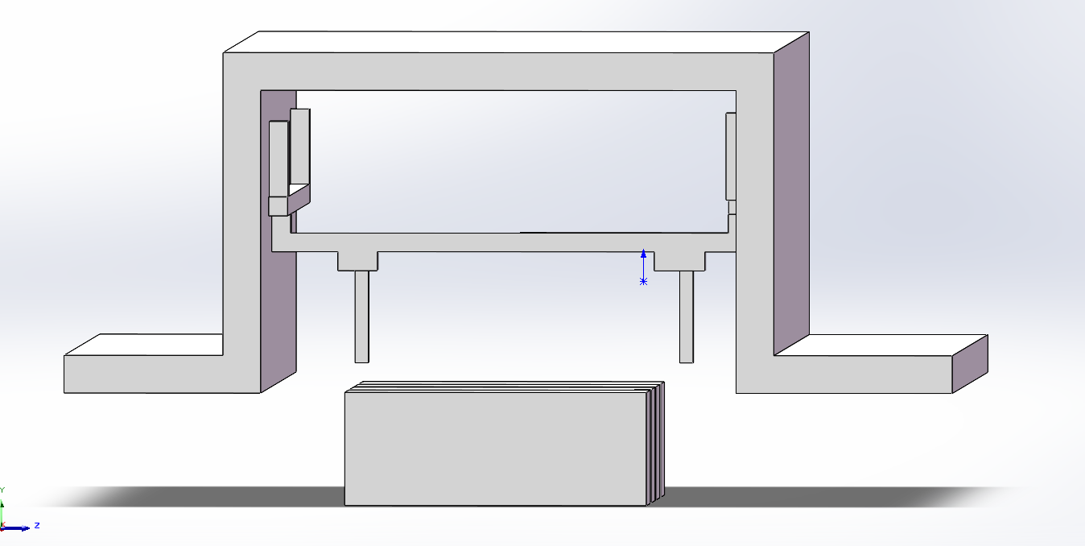
DESIGN
The position of the clamping fixture is adjusted by employing a combination of slide rails and slide blocks.
Page - 05

Slide 6
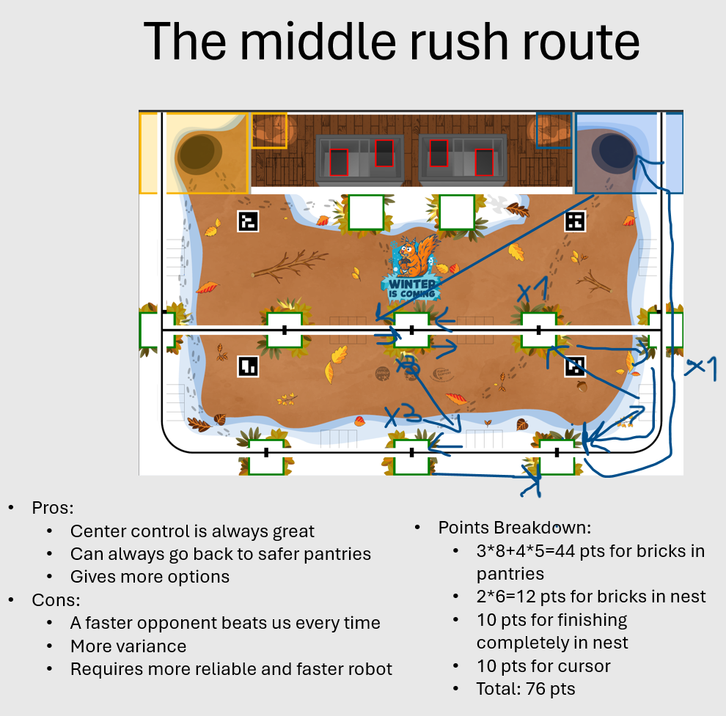
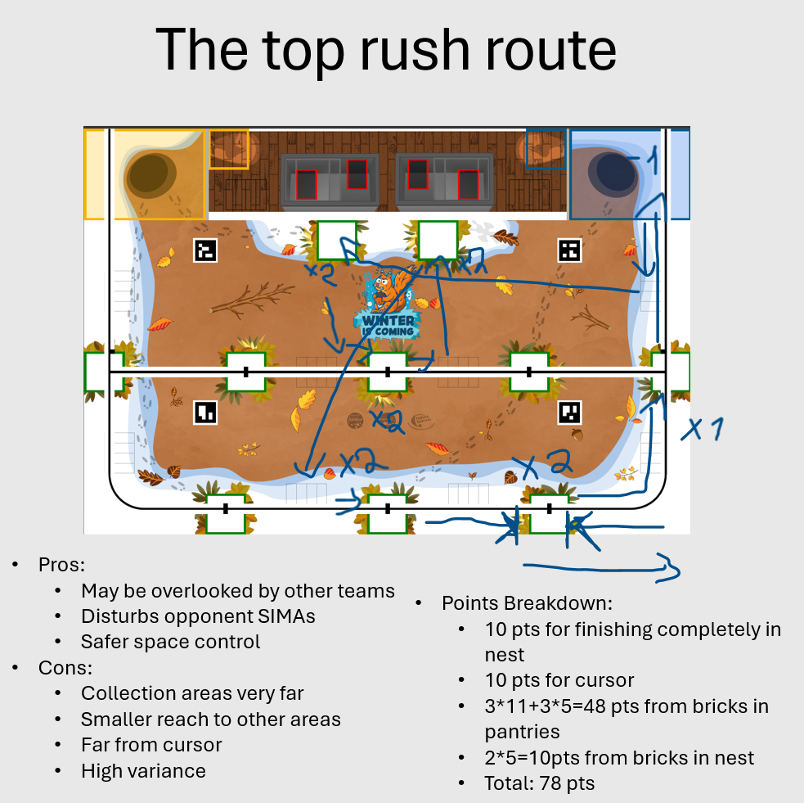
STRATEGIES
Chosen challenges to tackle: Challenges 1; 3; 4
First draft examples:
Page - 06

Slide 7
PROJECT MANAGEMENT
Tasks and Responsibilities
Samsam Ali BAIG | Designing, Electronics, Teams
Zad Abou JAOUDE | Electronics, Programming, GitHub
Sidy Thiaw | Programming, Simulation, GitHub
Zhonghe QIAO | Designing, Probant, Simulation
Papa Madiara SENE | Electronics, Designing, Probant
Page - 07

